Slide 1
Communication
Project: 101101139 — H-PASS — EU4H-2022-PJ

Slide 2
Contents
Introduction to Communication in Healthcare
Components and Process of Communication
Barriers to Effective Communication
Role of Verbal and Non-verbal Communication
Communication Styles in Healthcare Settings
Impact of eHealth and Electronic Communication
Case Studies and Practical Applications
Conclusion
Project: 101101139 — H-PASS — EU4H-2022-PJ

Slide 3
Learning objectives
Define key elements of effective communication in healthcare settings.
Identify & address common barriers to communication with patients and team members.
Describe the role and impact of verbal & non-verbal communication in patient care.
Differentiate communication styles & recognise the importance of assertive communication in healthcare.
Understand the benefits & limitations of electronic communication and eHealth in patient care & team coordination.
Project: 101101139 — H-PASS — EU4H-2022-PJ
Notes:
Orsi

Slide 4
Introduction
Communication in healthcare involves a range of skills, from verbal and written communication to non-verbal cues, which are essential for building trust and understanding.
Patient-professional communication models focus on the dynamic exchange of information, social interactions, relationships, and mutual expectations.
Effective communication within healthcare teams is critical for aligning care efforts, preventing misunderstandings, and promoting collaboration.
This module examines how communication skills impact patient care, team dynamics, and overall healthcare quality.
By exploring communication processes, barriers, styles, and technology's role, we aim to strengthen healthcare interactions for better patient outcomes.
Project: 101101139 — H-PASS — EU4H-2022-PJ

Slide 5
The communication process
Project: 101101139 — H-PASS — EU4H-2022-PJ

Slide 6
Please outline the essential components of the communication process in healthcare.
What are the main obstacles to effective communication?
Who can provide support to overcome these obstacles?
Project: 101101139 — H-PASS — EU4H-2022-PJ

Slide 7
Communication is a process by which information is exchanged between individuals through a common system of symbols, signs, or behavior.
Project: 101101139 — H-PASS — EU4H-2022-PJ

Slide 8
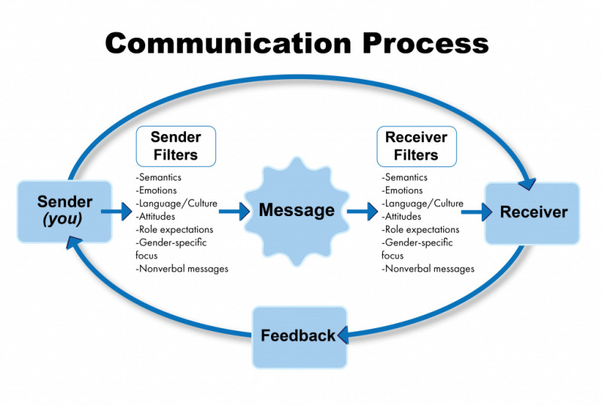
Project: 101101139 — H-PASS — EU4H-2022-PJ

Slide 9
Common barriers to communication in healthcare (I)
Jargon
Lack of attention
Noise & other distractions
Project: 101101139 — H-PASS — EU4H-2022-PJ

Slide 10
Common barriers to communication in healthcare (II)
Light
Hearing & speech problems
Language differences
Differences in cultural beliefs
Project: 101101139 — H-PASS — EU4H-2022-PJ

Slide 11
Common barriers to communication in healthcare (III)
Psychological barriers
Physiological barriers
Physical barriers to nonverbal communication
Differences in perceptions & viewpoints
Project: 101101139 — H-PASS — EU4H-2022-PJ

Slide 12
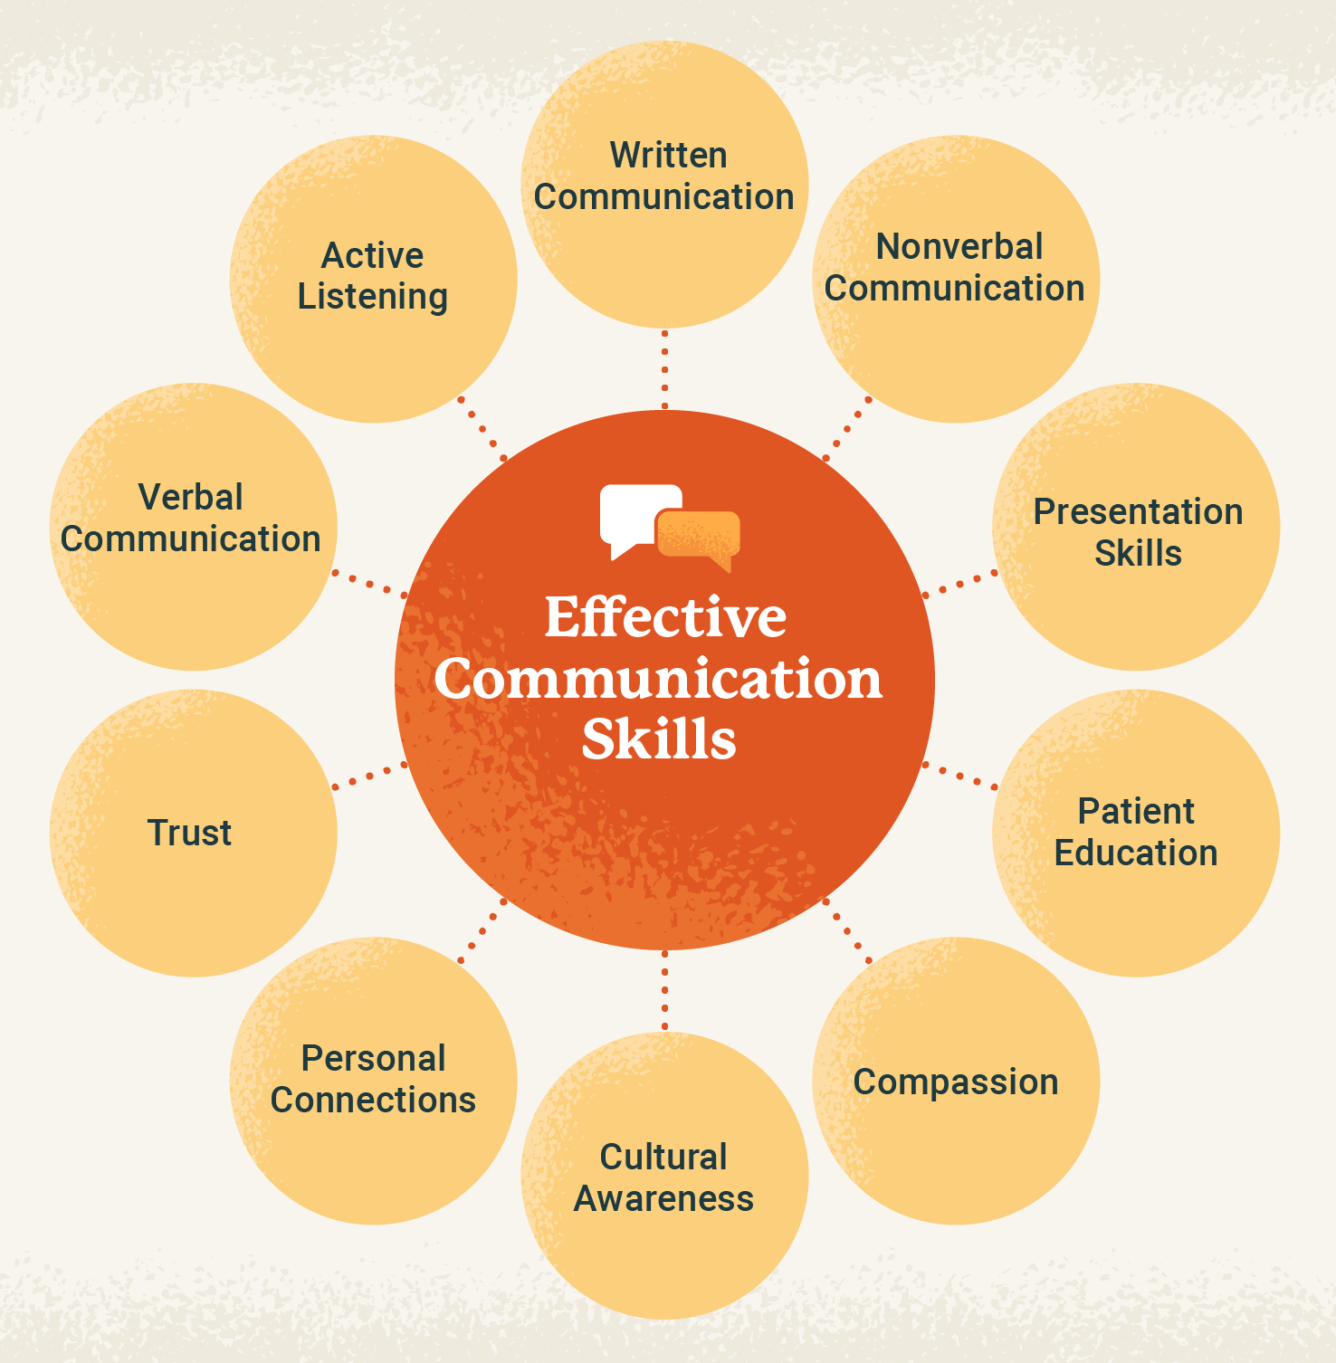
Project: 101101139 — H-PASS — EU4H-2022-PJ

Slide 13
Verbal Communication
Project: 101101139 — H-PASS — EU4H-2022-PJ

Slide 14
Key role
Encourage patients to communicate by asking open questions like, “Can you tell me a bit more about that?”
Avoid condescending pet names like “honey” or “sweetie” and instead use the patient’s first name or name of choice.
Speak in clear, complete sentences and avoid technical jargon.
Project: 101101139 — H-PASS — EU4H-2022-PJ

Slide 15
Example 1
Project: 101101139 — H-PASS — EU4H-2022-PJ

Slide 16
Example 2
Project: 101101139 — H-PASS — EU4H-2022-PJ

Slide 17
Non-verbal Communication
Project: 101101139 — H-PASS — EU4H-2022-PJ

Slide 18
Some facts
Language experts estimate that 70-93% of all communication is nonverbal.
Mehrabian’s communication theory suggests:
7% of all communication is through words
38% through tone and voice
55% through body language
Project: 101101139 — H-PASS — EU4H-2022-PJ

Slide 19
The power of non-verbal communication
Project: 101101139 — H-PASS — EU4H-2022-PJ

Slide 20
Key Aspects to Observe in Non-Verbal Communication
Project: 101101139 — H-PASS — EU4H-2022-PJ

Slide 21
Closed or Avoidant Body Language
Interpreting Body Language in Teams
Body language can have different meanings; a closed posture might simply indicate comfort or thoughtfulness.
Signs of discomfort may include turning away and avoiding eye contact.
Open body language (e.g., facing the speaker, nodding) demonstrates active listening and support.
Positive body language strengthens team relationships, enhancing collaboration and decision-making.
Attention to both obvious and subtle cues helps understand colleagues’ emotions and fosters a cohesive team environment.
https://www.betterup.com/blog/how-to-read-body-language
Project: 101101139 — H-PASS — EU4H-2022-PJ

Slide 22
Avoiding eye contact
The Role of Eye Contact in Communication
Eye contact varies culturally; in some cultures, avoiding it shows respect, while in others, it may signal discomfort.
Lack of eye contact with patients can indicate discomfort or mistrust—building rapport may be needed.In teams, consistent eye contact conveys engagement, attentiveness, and trust.
Recognising eye contact nuances helps improve communication with both patients and team members.
Project: 101101139 — H-PASS — EU4H-2022-PJ

Slide 23
Self-comforting body language
Recognising Self-Comforting Body Language
Self-comforting behaviours, such as hugging oneself or rubbing arms, may indicate distress or unhappiness.
Noticing these cues allows healthcare professionals to address patient discomfort in consultations.
Project: 101101139 — H-PASS — EU4H-2022-PJ

Slide 24
Emotive body language
Emotive Body Language and Its Indicators
Emotive gestures, such as holding one’s head in distress, making a fist, or wringing hands, reveal emotional states.
Recognising these non-verbal cues can help healthcare professionals address patients' underlying emotions effectively.
Project: 101101139 — H-PASS — EU4H-2022-PJ

Slide 25
Facial expressions
https://www.cio.com/article/272212/staff-management-how-to-be-a-mind-reader-the-art-of-deciphering-body-language.html
Observing and Interpreting Facial Expressions
Facial expressions offer insight into thoughts and emotions, helping us understand patients and colleagues better.
Observing non-verbal cues allows for more empathetic responses to patients’ needs and concerns.
Asking for clarification if a patient appears anxious builds trust and helps ensure accurate understanding.
In team settings, addressing a colleague's concerned expression can open dialogue and enhance collaboration.
Recognising and addressing facial expressions directly improves communication, promotes mutual understanding, and strengthens relationships in patient care and teamwork.
Project: 101101139 — H-PASS — EU4H-2022-PJ

Slide 26
Common Barriers to Effective Interprofessional Communication and Collaboration (I)
Personal values and expectations
Personality differences
Hierarchy
Disruptive behavior
Culture and ethnicity
Generational differences
Gender
Project: 101101139 — H-PASS — EU4H-2022-PJ

Slide 27
Common Barriers to Effective Interprofessional Communication and Collaboration (II)
Historical interprofessional and intraprofessional rivalries
Differences in language and jargon
Differences in schedules and professional routines
Varying levels of preparation, qualifications, and status
Differences in requirements, regulations, and norms of professional education
Fears of diluted professional identity
Project: 101101139 — H-PASS — EU4H-2022-PJ

Slide 28
Communication Styles
Passive communicator
Aggressive communicator
Assertive communicators
Project: 101101139 — H-PASS — EU4H-2022-PJ

Slide 29
E-health Communication
Project: 101101139 — H-PASS — EU4H-2022-PJ

Slide 30
Importance of Electronic Health Records (EHR) in Healthcare
Essential Tool: EHRs streamline patient-professional interactions and team communication.
Accessible Info: Provides up-to-date patient data for all healthcare providers.
Reduces Errors: Ensures accuracy, minimizing risks in patient care.
Enhances Teamwork: Clear documentation supports coordinated, multidisciplinary care.
Project: 101101139 — H-PASS — EU4H-2022-PJ

Slide 31
Advantages
Speed & convenience
Low cost
Reaches patients anywhere
Project: 101101139 — H-PASS — EU4H-2022-PJ

Slide 32
Disadvantages
More Vulnerable to Security Breaches.
Need a way to process large volumes of data.
Difficult to use for those who are “technologically challenged”.
Project: 101101139 — H-PASS — EU4H-2022-PJ

Slide 33
Case studies
Project: 101101139 — H-PASS — EU4H-2022-PJ

Slide 34
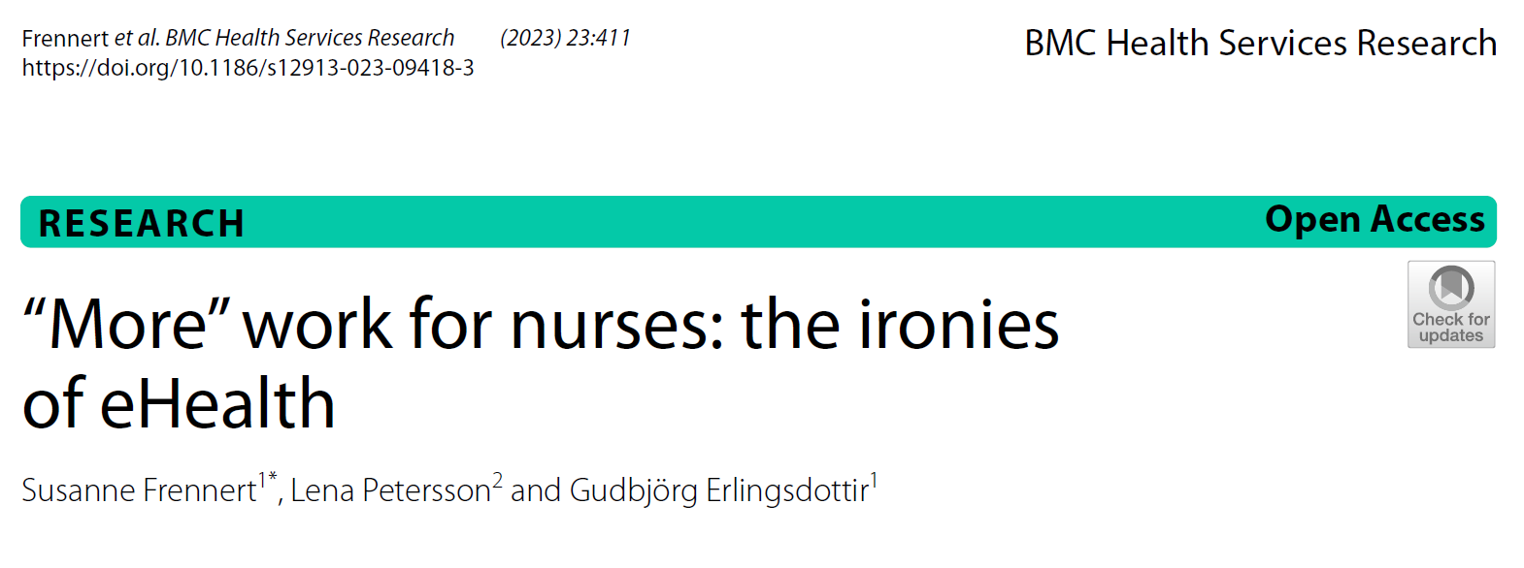
Project: 101101139 — H-PASS — EU4H-2022-PJ

Slide 35
Project: 101101139 — H-PASS — EU4H-2022-PJ

Slide 36
Project: 101101139 — H-PASS — EU4H-2022-PJ

Slide 37
Conclusion
Effective communication is fundamental to delivering high-quality, safe, and patient-centered care.
Clear communication supports trust-building, enhances patient outcomes, and fosters collaboration within multidisciplinary teams.
Strengthening both interpersonal and technological communication skills helps reduce errors and streamline care.
How we communicate influences individual interactions and impacts the entire healthcare system, promoting a cohesive and efficient care environment.
Project: 101101139 — H-PASS — EU4H-2022-PJ

Slide 38
References
Amsel, T. T. (2019). An Urban Legend Called: The 7/38/55 Ratio Rule. European Polygraph, 13(2), 96-99. https://doi.org/10.2478/ep-2019-0007
Frennert, S., Petersson, L., & Erlingsdottir, G. (2023). More work for nurses: The ironies of eHealth. BMC Health Services Research, 23(411). https://doi.org/10.1186/s12913-023-09418-3
O'Daniel, M., & Rosenstein, A. H. (2008). Professional communication and team collaboration. In R. G. Hughes (Ed.), Patient safety and quality: An evidence-based handbook for nurses (Chapter 33). Agency for Healthcare Research and Quality (US). https://www.ncbi.nlm.nih.gov/books/NBK2637/
Reuter-Sandquist, M. (2022). Nursing Assistant. In K. Ernstmeyer & E. Christman (Eds.), Chippewa Valley Technical College. Open Educational Resource (OER) under Creative Commons Attribution 4.0 License.
Svendsen, M. T., Tiedemann, S. N., & Andersen, K. E. (2021). Pros and cons of eHealth: A systematic review of the literature and observations in Denmark. SAGE Open Medicine, 9, 1-10. https://doi.org/10.1177/20503121211016179
Project: 101101139 — H-PASS — EU4H-2022-PJ

Slide 39
Copyright notice
Copyright © Members of the H-PASS Project. For details about the H-PASS Project and collaboration, please visit: https://hpass.healthworkforce.eu/index.php/the-project/
H-PASS the “Health Professionals’ and the “DigitAl team” SkillS advancement” is a project co-funded by the European Health and Digital Executive Agency (HaDEA) under the powers delegated by the European Commission. H-PASS began in May 2023 and will run for 3 years.
This work is licensed under the Creative Commons Attribution-Noncommercial 3.0 License. To view a copy of this license, visit http://creativecommons.org/licenses/by-nc/3.0/ or send a letter to Creative Commons, 171 Second Street, Suite 300, San Francisco, California, 94105, and USA.
The work must be attributed by attaching the following reference to the copied elements: “Copyright © Members of the H-PASS Project ”.
Using this presentation in a way and/or for purposes not foreseen in the license, requires the prior written permission of the copyright holders. The information contained in this presentation represents the views of the copyright holders as of the date such views are published.
Project: 101101139 — H-PASS — EU4H-2022-PJ

Slide 40
Disclaimer
The European Health and Digital Executive Agency (HaDEA), under the powers delegated by the European Commission, supports the production of this publication. The European Commission's support does not constitute endorsement of the contents, which reflects the views only of the authors. The Commission cannot be held responsible for any use that may be made of the information contained therein.
Project: 101101139 — H-PASS — EU4H-2022-PJ

Slide 41
End of learning unit
Project: 101101139 — H-PASS — EU4H-2022-PJ

