Slide 1
Conflict
Project: 101101139 — H-PASS — EU4H-2022-PJ

Slide 2
Contents
Introduction
Definition & Nature of Conflict
Causes & Types of Conflict
Positive Aspects of Conflict
The Thomas-Kilmann Conflict Model
Conflict Management Styles in Healthcare
Conclusion
Project: 101101139 — H-PASS — EU4H-2022-PJ

Slide 3
Learning objectives
Understand what conflict is, its causes, and how it manifests in interactions.
Recognise how well-managed conflict can drive improvement, innovation, and mutual understanding.
Examine the Thomas-Kilmann Conflict Model and identify key styles—competing, avoiding, accommodating, collaborating, and compromising.
Understand practical conflict resolution methods tailored for healthcare teams and settings.
Project: 101101139 — H-PASS — EU4H-2022-PJ
Notes:
Orsi

Slide 4
Introduction
Conflict is a natural part of human interaction, emerging across settings like home, workplace, and society.
It goes beyond simple disagreements, often involving perceived incompatibilities in goals, values, or interests.
While it can be uncomfortable, conflict provides an opportunity to address hidden issues, challenge assumptions, and promote growth.
When managed constructively, conflict fosters stronger relationships, productivity, and positive outcomes.
This module explores conflict’s causes, types, and effective management strategies, focusing on healthcare where teamwork and communication are crucial.
Project: 101101139 — H-PASS — EU4H-2022-PJ

Slide 5
Definition of Conflict
Lat. conflictus – clash, clash of opposing interests, goals, views, attitudes. Conflict causes intense unpleasantness.
A distinction is made between:
Psychic (clash of opposing incompatible tendencies which cannot be realised simultaneously).
Social (can be between social groups, states, nations, social movements, interest groups, classes, genders, political parties, ethnic racial or religious groups).
Project: 101101139 — H-PASS — EU4H-2022-PJ

Slide 6
Potential causes of Conflict
Basic needs (necessities for survival – food, water, air)
Psychological needs (to feel capable, important, healthy, accepted by others)
Different values (beliefs, worldview, religion)
Different perceptions (when there are different opinions about the same thing), different interests, limited resources)
Project: 101101139 — H-PASS — EU4H-2022-PJ

Slide 7
Positive aspects of Conflict
Encourages Hard Work
Satisfies Psychological Needs
Generates Creative Ideas
Drives Social and Organizational Change
Facilitates Mutual Understanding and Group Unity
Encourages Group Cooperation
Inspires Creativity
Fosters Opinion Sharing and Respect
Prevents Premature Decision Making
Promotes Mutual Understanding and Agreement
Project: 101101139 — H-PASS — EU4H-2022-PJ

Slide 8
Intensity of Conflict
(de Jong, De Bruin, Knoop, & van Vliet, 2021)
Project: 101101139 — H-PASS — EU4H-2022-PJ

Slide 9
Types of Conflict in Healthcare
Project: 101101139 — H-PASS — EU4H-2022-PJ

Slide 10
Information Conflicts
When there is different or insufficient information available or a disagreement on what information is relevant.
Lost or missing medical notes, information missed off a prescription and poor handovers are all common examples.
Project: 101101139 — H-PASS — EU4H-2022-PJ

Slide 11
Value Conflicts
Incompatible belief systems or trying to impose personal values onto others.
Values do not tend to be negotiable and this can often lead to conflict between the member of staff and whoever they deem responsible.
Project: 101101139 — H-PASS — EU4H-2022-PJ

Slide 12
Interest Conflicts
Competition over needs or resources such as money or time.
Project: 101101139 — H-PASS — EU4H-2022-PJ

Slide 13
Relationship Conflicts
Negative emotions, distrust, misconceptions or poor communication between people.
The reasons for such conflicts can be many, as stressful environments and emotional situations can breed these emotions very easily.
Project: 101101139 — H-PASS — EU4H-2022-PJ

Slide 14
Structural Conflicts
Oppressive behaviour toward others, a lack of resources or opportunities and the structure of an organisation.
Healthcare organizations can have a high turnover of staff.
Project: 101101139 — H-PASS — EU4H-2022-PJ

Slide 15
How to handle conflicts with colleagues
Act and speak calmly
Try to implement positive confrontation techniques
You can seek advice from a manager or mediator or ask them for a chat if appropriate
Choose a neutral space away from other colleagues, service users, patients, and their families
Listen and clarify the issue on both sides
Work together to tackle the problem and seek advice if unable to do so
Thank them for hearing you out
Project: 101101139 — H-PASS — EU4H-2022-PJ

Slide 16
How to handle conflicts with patient /family
Act and speak calmly
1
Be patient and understanding – they may need your empathy and compassion
2
Actively listen to understand their concerns and requests
3
Always remember a patient-centered approach to care and their rights
4
Evaluate a solution, which may require multiple parties and healthcare professionals
5
Clearly communicate information
6
Consider providing additional reading materials for them if being more informed about certain topics would help them
7
Decide on a mutually acceptable solution together
8
Project: 101101139 — H-PASS — EU4H-2022-PJ

Slide 17
You will now watch two videos featuring healthcare professionals managing conflict situations. Pay close attention to verbal and non-verbal communication, decision-making processes, and overall conflict management techniques used in each scenario.
After watching, please answer the following:
What did the professionals do well in handling the conflict? Provide specific examples from the video.
What could have been improved? Identify mistakes or missed opportunities in communication or conflict resolution.
How would you personally handle this situation differently? Suggest alternative strategies or approaches and explain why they might be more effective.
Consider the broader implications: How might this conflict, if unresolved, affect patient care, teamwork, or the healthcare environment?
Project: 101101139 — H-PASS — EU4H-2022-PJ

Slide 18
Situation no.1
Project: 101101139 — H-PASS — EU4H-2022-PJ

Slide 19
Situation no.2
Project: 101101139 — H-PASS — EU4H-2022-PJ

Slide 20
Conflict Handling Styles
Project: 101101139 — H-PASS — EU4H-2022-PJ

Slide 21
Thomas and Kilmann’s Conflict Model
Provides a framework for understanding conflict management styles.
Highlights conflict as both challenging and a test of managerial skills.
Emphasises that individuals respond uniquely to conflicts.
Developed through observing real-life interpersonal conflict scenarios.
Identifies five primary approaches people use to manage conflicts effectively.
Project: 101101139 — H-PASS — EU4H-2022-PJ

Slide 22
The five modes of conflict management
Project: 101101139 — H-PASS — EU4H-2022-PJ

Slide 23
Two different approaches
Option 1 Assertiveness
Option 2 Cooperativeness
Indicates willingness to take initiative and assert will.
Useful when:
Quick results are needed.
Ethical or moral issues arise.
You are certain of your correctness.
Previous attempts to resolve conflict have failed.
Significant power and influence exist.
Benefits: Leads to faster resolution and reinforces power.
Drawbacks: Can create friction, lower morale, and reinforce hierarchies.
Indicates willingness to work together towards a goal.
Preferred when:
No clear best solution exists.
Your viewpoint may not be correct.
The opponent is cooperative or agreeable.
Minimizing workplace threats is important.
Advantages: Reduces fallout and improves reputation as a diplomat.
Challenges: Time-consuming to achieve consensus; difficult with stubborn parties.
Project: 101101139 — H-PASS — EU4H-2022-PJ

Slide 24
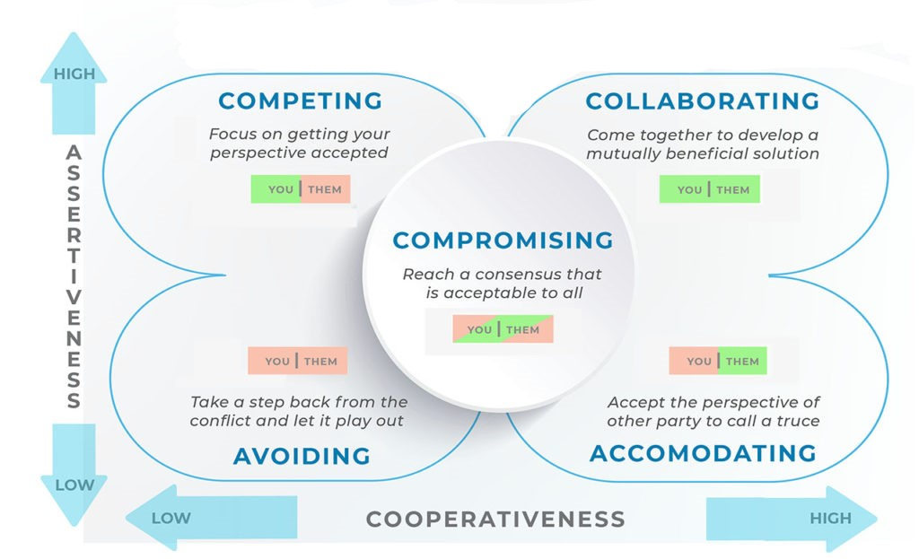
Competing
Project: 101101139 — H-PASS — EU4H-2022-PJ

Slide 25
Avoiding
Project: 101101139 — H-PASS — EU4H-2022-PJ

Slide 26
Accomodating
Project: 101101139 — H-PASS — EU4H-2022-PJ

Slide 27
Collaborating
Project: 101101139 — H-PASS — EU4H-2022-PJ

Slide 28
Compromising
Project: 101101139 — H-PASS — EU4H-2022-PJ

Slide 29
Thomas Killman test
THOMAS-KILMANN CONFLICT MODE QUESTIONNAIRE
SCORING THE THOMAS-KILMANN CONFLICT MODE QUESTIONNAIRE
PROFILE AND INTERPRETIVE REPORT
Project: 101101139 — H-PASS — EU4H-2022-PJ

Slide 30
Conclusion
Conflict, while sometimes uncomfortable, is an integral and valuable aspect of dynamic work environments.
By recognising the causes, intensities, and management styles, we can transform conflict into a tool for positive change.
Effective conflict resolution not only improves communication and cooperation but also promotes a healthy and productive work atmosphere.
Applying these strategies can enhance teamwork and foster better patient care outcomes in healthcare.
Project: 101101139 — H-PASS — EU4H-2022-PJ

Slide 31
References
Afolaranmi, A. O. (2022). Conflict Management Mechanisms through Social Media among the Nigerian Baptist Pastors. IRA-International Journal of Management & Social Sciences (ISSN 2455-2267), 18(1), 1-12. DOI: https://dx.doi.org/10.21013/jmss.v18.n1.p1
De Bruin, S., Knoop, J., Visser, H., & Ligtvoet, W. (2018). Linking Water Security Threats to Conflict: An Exploration of Pathways. PBL Netherlands Environmental Assessment Agency.
de Jong, L., De Bruin, S., Knoop, J., & van Vliet, J. (2021). Understanding land-use change conflict: A systematic review of case studies. Journal of Land Use Science. https://doi.org/10.1080/1747423X.2021.1933226
Kim S. et al. Individual, interpersonal, and organisational factors of healthcare conflict: A scoping review. Journal of Interprofessional Care. Volume 31, 2017 - Issue 3
MTD Training. (2023, September 21). What is the Thomas Kilmann Conflict Management Model? (With examples). MTD Training. Retrieved from https://www.mtdtraining.com/blog/thomas-kilmann-conflict-management-model.htm
Thomas, K. W., & Kilmann, R. H. (2008). Thomas-Kilmann Conflict Mode Instrument: Profile and Interpretive Report. CPP, Inc.
Wenxue Lu, Jishuang Wang, The influence of conflict management styles on relationship quality: The moderating effect of the level of task conflict, International Journal of Project Management, Volume 35, Issue 8, 2017, Pages 1483-1494
Project: 101101139 — H-PASS — EU4H-2022-PJ

Slide 32
Copyright notice
Copyright © Members of the H-PASS Project. For details about the H-PASS Project and collaboration, please visit: https://hpass.healthworkforce.eu/index.php/the-project/
H-PASS the “Health Professionals’ and the “DigitAl team” SkillS advancement” is a project co-funded by the European Health and Digital Executive Agency (HaDEA) under the powers delegated by the European Commission. H-PASS began in May 2023 and will run for 3 years.
This work is licensed under the Creative Commons Attribution-Noncommercial 3.0 License. To view a copy of this license, visit http://creativecommons.org/licenses/by-nc/3.0/ or send a letter to Creative Commons, 171 Second Street, Suite 300, San Francisco, California, 94105, and USA.
The work must be attributed by attaching the following reference to the copied elements: “Copyright © Members of the H-PASS Project ”.
Using this presentation in a way and/or for purposes not foreseen in the license, requires the prior written permission of the copyright holders. The information contained in this presentation represents the views of the copyright holders as of the date such views are published.
Project: 101101139 — H-PASS — EU4H-2022-PJ

Slide 33
Disclaimer
The European Health and Digital Executive Agency (HaDEA), under the powers delegated by the European Commission, supports the production of this publication. The European Commission's support does not constitute endorsement of the contents, which reflects the views only of the authors. The Commission cannot be held responsible for any use that may be made of the information contained therein.
Project: 101101139 — H-PASS — EU4H-2022-PJ

Slide 34
End of learning unit
Project: 101101139 — H-PASS — EU4H-2022-PJ

