Slide 1
Cultural Competence in Healthcare Services
Project: 101101139 — H-PASS — EU4H-2022-PJ

Slide 2
Contents
Introduction to Cultural Competence in Healthcare
The Need for Cultural Competence
Key Approaches to Cultural Competence
Outcomes of Implementing Cultural Competence Approaches
Future Directions and Key Messages
Conclusion
Project: 101101139 — H-PASS — EU4H-2022-PJ

Slide 3
Learning objectives
Understand the key concepts, historical background, and significance of cultural competence in healthcare.
Learn about the challenges and barriers that arise from the absence of cultural competence and how it impacts patient outcomes.
Examine the main models and strategies for achieving cultural competence at individual, organisational, and systemic levels.
Analyse the benefits of cultural competence for patients, healthcare providers, and organizations.
Understand how cultural competence complements patient-centered care and how both can be applied to improve healthcare services.
Project: 101101139 — H-PASS — EU4H-2022-PJ
Notes:
Orsi

Slide 4
Introduction
Cultural competence in healthcare refers to the ability of providers and systems to deliver care that respects and responds to the diverse cultural backgrounds of patients.
This course will explore the importance of cultural competence, how it has evolved, and the strategies for applying it to improve healthcare outcomes.
By understanding and implementing cultural competence, healthcare professionals can better serve diverse populations, reduce health disparities, and promote equitable care.
Project: 101101139 — H-PASS — EU4H-2022-PJ

Slide 5
What is cultural competence (CC) in healthcare?
“A set of congruent behaviours, attitudes and policies that come together in a system, agency or amongst professionals and enables that system, agency or those professionals to work effectively in cross-cultural situations” (Cross et al., 1989)
A culturally competent system…
Values diversity
Has capacity for cultural self-assessment
Is conscious of the inherent dynamics when cultures interact
Has institutionalised cultural knowledge
Has developed adaptations to diversity
Project: 101101139 — H-PASS — EU4H-2022-PJ

Slide 6
Some historical roots of CC: from early stages in the ’70s to nowadays
Initially conceived in the ’70s as variety of interventions improving the accessibility and effectiveness of healthcare services especially for people from ethnic minorities, cultural competence expanded in the late ’80s and ’90s in 3 main ways (Saha et al., 2008):
The populations to whom cross-cultural care was applied expanded from primarily immigrants to essentially all minority groups, particularly those most affected by racial disparities in the quality of healthcare;
The conceptual purview of cultural competence expanded beyond culture per se and encompassed issues such as prejudice, stereotyping and social determinants of health;
Finally, the scope of cultural competence expanded beyond the interpersonal domain of cross-cultural care to include health systems and communities.
Project: 101101139 — H-PASS — EU4H-2022-PJ

Slide 7
Effectiveness & appropriateness as key concepts of CC models
Generally, cultural competence is the ability to work and communicate effectively and appropriately with people from culturally different backgrounds (Alizadeh et al., 2016)
While appropriateness implies not violating the valued rules, effectiveness means achieving the valued goals and outcomes in intercultural interactions (Spitzberg, 1989).
Cultural competence is an ongoing process, not an endpoint event, meaning that competency capability can be continuously enhanced over time (Alizadeh et al., 2016).
Project: 101101139 — H-PASS — EU4H-2022-PJ

Slide 8
Components of a CC model: to know, to behave, to be able
ATTITUDES
1
2
Motivation or willingness to engage, participate and learn about cultural diversity and to raise his/her cultural awareness, knowledge and skills, through face-to-face contacts or other types of interactions with culturally different people.
KNOWLEDGE
Individual’s awareness of her/his own views such as ethnocentric, biased and prejudiced beliefs towards other cultures, and the continued acquisition of information about other cultures, understanding their importance to healthcare delivery processes.
CC model in healthcare
SKILLS
Communication and behavioral ability to interact effectively with culturally different people. For ex., the ability to make an accurate physical assessment and collect health data of culturally/ethnically diverse patients.
3
Project: 101101139 — H-PASS — EU4H-2022-PJ

Slide 9
CC models need to be placed inside the broader context
Whether CC models in healthcare may produce positive impacts in terms of patient outcomes (quality of life, satisfaction, adherence to treatments, etc.) and in terms of organizational benefits (enhanced job performance, better interpersonal relationships, etc.) is NOT merely determined by the capability of an individual, but is shaped by the larger context as it can affect outcomes directly and indirectly by influencing the individual’s behaviour.
Cultural distance
Cultural distance is the actual or perceived discrepancy between one’s own cultural practices and values and those of another culture.
A very culturally different environment may cause individuals to experience high levels of stress, and may undermine their aptitude to adapt effectively (Johnson et al. 2006).
Organisational support
Organisational support varies in the degree to which agencies encourage or impede cultural competence through policies, procedures and allocation of resources in everyday practices, determining an employee’s capability to achieve desirable outcomes and deliver culturally competent services (Balcazar et al. 2009).
Institutional ethnocentrism
Institutional ethnocentrism promotes the home culture’s ways of behaving and accomplishing tasks, with negative impact on an individual’s ability to respond appropriately to cultural differences in the workplace (Johnson et al. 2006).
Institutional ethnocentrism can deter an individual from using his/her cultural knowledge and skills to achieve favorable outcomes (Abbe et al. 2007).
Adoption of cultural knowledge and skills can be facilitated or hindered by the degree of organisational support where the service providers work.
Project: 101101139 — H-PASS — EU4H-2022-PJ

Slide 10
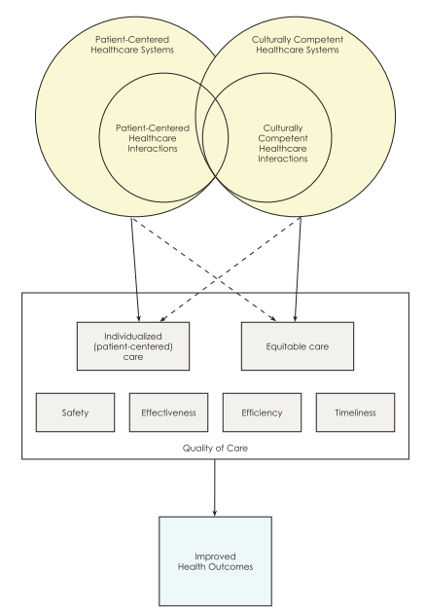
CC & patient-centered care are intertwined (1/3)
Patient-centered care (e.g. Lipkin, 1984) and CC are both approaches that aim to improve healthcare quality, but the emphasis of each is on different aspects:
Individualising care must take into account the diversity of patient values and perspectives; to the extent that patient-centered care is delivered universally, care should become more equitable.
Conversely, attending to the specific needs of marginalized/disadvantaged populations must take into account the wide range of worldviews within a given group, and the multifaceted nature of “culture;” to the extent that cultural competence enhances the ability of health systems and providers to address individual patients’ preferences and goals, care should become more patient centered.
Project: 101101139 — H-PASS — EU4H-2022-PJ
Source: Saha et al. (2008)

Slide 11
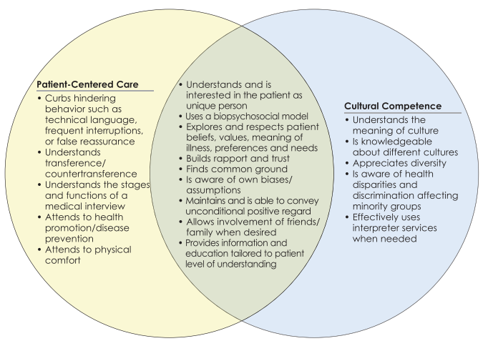
CC & patient-centered care are intertwined at individual level (2/3)
Patient-centered care
Cultural competence
On individual level (professionals)
Project: 101101139 — H-PASS — EU4H-2022-PJ
Source: Saha et al. (2008)

Slide 12
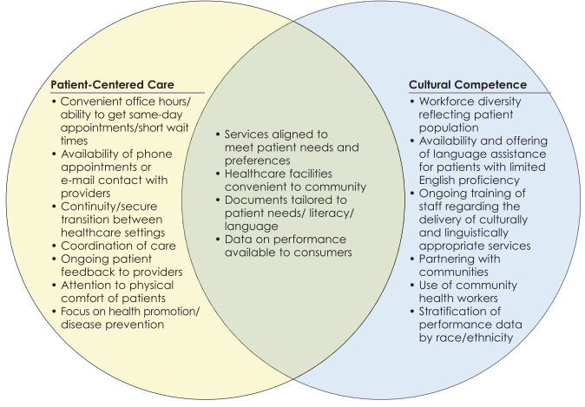
CC & patient-centered care are intertwined at a system level (3/3)
Patient-centered care
Cultural competence
On a health system level
Project: 101101139 — H-PASS — EU4H-2022-PJ
Source: Saha et al. (2008)

Slide 13
CC needed to overcome several barriers… (1/2)
Cultural beliefs
Socio-economic barriers
Institutional barriers
Language
barriers
Trust with the health system
Health
literacy
Social determinants of health
Communication Issues
Miscommunication Risks
Health Beliefs:
Traditional Practices
Historical Trauma and Distrust
Perceived Discrimination
Access to Services
Resource Limitations
Understanding Medical Information
Effective Communication
Policy and Practice Gaps
Workforce Diversity
Environmental Factors
Community Resources
Project: 101101139 — H-PASS — EU4H-2022-PJ

Slide 14
CC needed to overcome several barriers… (2/2)
Cultural
beliefs
Socio-economic barriers
Institutional barriers
Language
barriers
Trust with the health system
Health
literacy
Social determinants of health
Communication Issues:
Patients with limited English proficiency may have difficulty understanding medical information, instructions, and navigating the healthcare system.
Miscommunication Risks:
Language barriers can lead to misunderstandings, misdiagnoses, and inappropriate treatments.
Health Beliefs:
Different cultural groups may have unique beliefs about health, illness, and treatment, which can affect their healthcare decisions and compliance with medical advice.
Traditional Practices: Patients may prefer traditional or alternative medicine practices over conventional medical treatments, leading to potential conflicts or misunderstandings with healthcare providers.
Historical Trauma and Distrust:
Some communities, particularly Indigenous populations and minority groups, may have historical reasons for distrusting the healthcare system due to past discrimination and mistreatment.
Perceived Discrimination: Experiences of bias or discrimination can deter individuals from seeking care or fully engaging with healthcare providers.
Access to Services: Income, education, and employment can affect a person’s ability to access healthcare services, including preventive care and timely treatments.
Resource Limitations: Patients from lower socioeconomic backgrounds may face challenges such as lack of transportation, childcare, or insurance coverage, which can impede their ability to obtain care.
Understanding Medical Information:
Patients may have varying levels of health literacy, affecting their ability to understand medical terminology, treatment options, and health instructions.
Effective Communication: Ensuring that health information is communicated in a way that is understandable and actionable for patients with different literacy levels is crucial.
Policy and Practice Gaps:
Lack of institutional policies that support cultural competence can lead to inconsistent care and barriers to accessing culturally appropriate services.
Workforce Diversity:
A lack of diversity among healthcare providers can result in cultural mismatches between providers and patients, affecting the quality of care.
Environmental Factors: Factors such as housing, food security, and social support can significantly impact health outcomes and access to care.
Community Resources: Limited availability of culturally relevant community resources and support services can hinder effective healthcare delivery.
Project: 101101139 — H-PASS — EU4H-2022-PJ

Slide 15
…and also, to fight the risk of stereotyping and bias
Implicit Bias: Unconscious biases among healthcare providers can affect their interactions with patients and lead to disparities in care.
Stereotyping: Assuming that all members of a cultural group are the same can result in inappropriate care and a lack of individualised treatment.
FitzGerald & Hurst (2017), in their systematic review of the literature, found that:
Correlational evidence indicates that implicit biases of healthcare professionals are likely to influence diagnosis and treatment decisions and levels of care in some circumstances.
All the studies that investigated correlations found a significant positive relationship between level of implicit bias and lower quality of care.
Project: 101101139 — H-PASS — EU4H-2022-PJ

Slide 16
Three-level approaches towards CC models: individual, organisational and systemic (1/2)
INDIVIDUAL
ORGANISATIONAL
SYSTEMIC
Education and Training
Self-Assessment and Reflection
Mentoring and Coaching
Diverse Workforce
Policy and Procedure Development
Language Services
Patient-Centered Care Models
Community Engagement and Partnerships
Research and Data Collection
Policy Advocacy
Accreditation and Standards
Project: 101101139 — H-PASS — EU4H-2022-PJ

Slide 17
Three-level approaches towards CC models: individual, organisational and systemic (2/2)
INDIVIDUAL
ORGANISATIONAL
SYSTEMIC
Education and Training:
Cultural Competence Training: Workshops, seminars, and courses focused on cultural awareness, sensitivity, and practical skills for interacting with diverse patient populations.
Language Training: Offering courses in commonly spoken languages within the community to improve direct communication with patients.
Self-Assessment and Reflection:
Encouraging healthcare providers to engage in self-assessment to recognize and address their own biases and assumptions.
Reflective practices such as journaling or group discussions about cultural encounters can help providers understand and improve their cultural competence.
Mentoring and Coaching:
Pairing less experienced staff with culturally competent mentors can provide guidance and model effective practices.
Ongoing coaching to support continuous improvement in cultural competence skills.
Diverse Workforce:
Hiring practices that promote a diverse healthcare workforce reflective of the community served.
Creating an inclusive work environment that values and respects cultural diversity.
Policy and Procedure Development:
Implementing policies that require cultural competence training for all staff.
Establishing guidelines for culturally appropriate care practices and patient interactions.
Language Services:
Providing access to interpreters and translation services for patients.
Ensuring that written materials (e.g., consent forms, patient education materials) are available in multiple languages.
Patient-Centered Care Models:
Adopting care models that emphasize personalized care plans that consider patients’ cultural beliefs, values, and practices.
Incorporating cultural competence into patient care protocols and quality improvement initiatives.
Community Engagement and Partnerships:
Building relationships with community leaders to address the health needs of diverse populations.
Collaborating with community-based organizations to provide culturally relevant health education and services.
Research and Data Collection:
Conducting research on health disparities and the impact of cultural competence on health outcomes.
Collecting and analyzing data on patient demographics, language needs, and health outcomes to inform targeted interventions.
Policy Advocacy:
Advocating for policies that promote health equity and address social determinants of health.
Supporting legislation that ensures access to culturally competent care for all populations.
Accreditation and Standards:
Encouraging healthcare organizations to seek accreditation for cultural competence.
Adhering to standards and best practices for cultural competence set by professional organisations and accrediting agencies.
Project: 101101139 — H-PASS — EU4H-2022-PJ

Slide 18
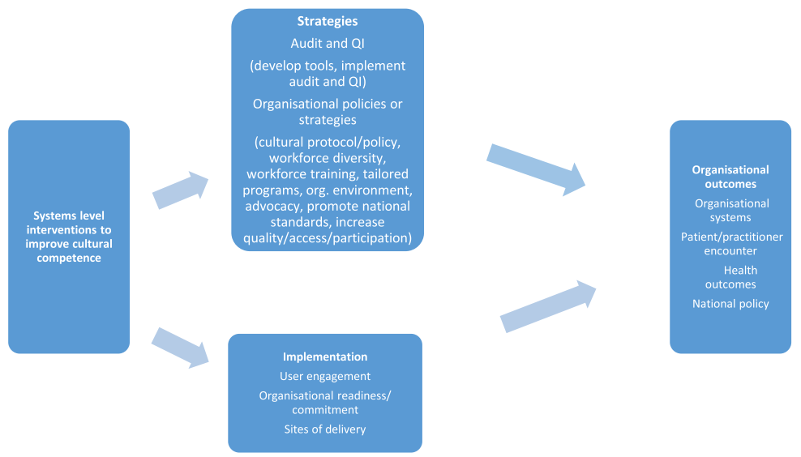
Implementation of CC models: principles-strategies-outcomes framework
Key principles for implementing systems approaches are: user engagement, organizational readiness, and delivery across multiple sites.
Two key types of intervention strategies to embed cultural competence within health systems were: audit and quality improvement approaches and service-level policies or strategies.
Outcomes are found for organizational systems, the client/practitioner encounter, health, and at national policy level.
Framework by McCalman et al. (2017)
Source: McCalman et al. (2017)
Project: 101101139 — H-PASS — EU4H-2022-PJ

Slide 19
Examples of CC models in healthcare systems around the world
In GERMANY, MiMi (With Migrants for Migrants), a project to train migrants as health mediators to educate the community
In USA, Culturally and Linguistically Appropriate Services (CLAS) Standards, established by the Office of Minority Health, provide a framework for organizations to offer culturally and linguistically appropriate services.
In CANADA, Toronto Central Local Health Integration Network (LHIN), that incorporates cultural competence into health planning and delivery
In SWEDEN, Intercultural opening, a training program for health professionals to improve their cultural competence
In NEW ZEALAND, Whānau Ora, a health initiative that focuses on the well-being of Māori families through a holistic approach
In UK, NHS Equality and Diversity Council provides guidance on implementing culturally competent practice
Project: 101101139 — H-PASS — EU4H-2022-PJ

Slide 20
Applied example of CC in health: diabetes prevalence varies according to ethnicity
There’s rationale for CC approach!
5 fundamental step strategy
Language accessibility of treatment interventions
Trust building through community outreach
Tailoring care plans to cultural norms
Culturally relevant health education
Respecting traditional beliefs/cultural habits

Slide 21
CC models are usually measured on these outcomes
1
PATIENT SATISFACTION
4
PROFESSIONAL-PATIENT RELATIONSHIP
2
HEALTH OUTCOMES
5
ORGANISATIONAL BENEFITS
3
ACCESS TO HEALTHCARE SERVICES
6
COST-EFFECTIVENESS & POTENTIAL SAVINGS
Project: 101101139 — H-PASS — EU4H-2022-PJ

Slide 22
Evidences indicate positive results, but still more research is needed! (1/2)
Evidences demonstrate effectiveness of PCC with CC models in terms of clinician/practitioner cultural knowledge, awareness and sensitivity. No significant effect on patients outcomes. (Renzaho et al., 2013)
In Chae et al. (2020) study, there is evidence of significantly improved health professional outcomes compared to the control group, whereas limited evidence report significant effect on patient satisfaction and trust. There is no significant effect on patient physiological outcomes.
Project: 101101139 — H-PASS — EU4H-2022-PJ

Slide 23
Evidences indicate positive results, but still more research is needed! (2/2)
Truong et al. (2014) indicate that interventions for cultural competency can improve patient health outcomes. However, a lack of methodological rigor is common amongst the studies included in reviews and many of the studies rely on self-report, which is subject to a range of biases
Handtke et al. (2019) state that the overall effects on patient outcomes and utilization rates of identified CC strategies were positive but often small or not significant. Qualitative data suggest that components and strategies of culturally competent healthcare were appreciated by patients and providers.
Project: 101101139 — H-PASS — EU4H-2022-PJ

Slide 24
CC in health is a still flourishing and evolving topic…
“CC is not something we achieve or fail to achieve but rather a reminder to continue to strive to know more about communities of all types with which we work or interact.” (Greene-Moton et al., 2020, p.4)
This is why it should embed the concept of cultural humility conceived as “a lifelong commitment to self-evaluation and critique, to redressing power imbalances […] and to developing mutually beneficial and non-paternalistic partnerships with communities on behalf of individuals and defined populations” (Tervalon & Murray-García, 1998, p.123)
Together with the concept and embodied practice of deep cultural humility, CC provides health educators and other public health professionals with some of the most important tools in working with diverse individuals, groups, and communities in today’s complex world.
Project: 101101139 — H-PASS — EU4H-2022-PJ

Slide 25
Key messages & wrap up
CC in health as a set of approaches combining knowledge, attitudes and skills to work and communicate effectively and appropriately with people from culturally different backgrounds.
CC’s effectiveness depend on the broader context of application, where 3 factors are relevant: cultural distance, institutional ethnocentrism, organisational support.
CC and PCC models are intertwined: they pursue the same goals with different methods and perspectives.
CC approaches are needed to overcome several barriers in healthcare services, both on the patients and patients' side.
3-levels approaches to implement CC models: individual, organisational and systemic-based interventions.
To effectively implement CC models, principles, strategies and desired outcomes have to be aligned.
Research shows positive results of CC, especially in terms of professionals and organisational outcomes; more research is needed on patients' outcomes.
CC and cultural humility for better healthcare services in today’s complex and more diverse world.
Project: 101101139 — H-PASS — EU4H-2022-PJ

Slide 26
Conclusion
Cultural competence is essential for delivering high-quality healthcare in today’s diverse world.
By recognising and addressing cultural differences, healthcare professionals can improve patient outcomes, build trust, and foster more inclusive and equitable care environments.
Ongoing commitment to cultural competence, combined with cultural humility, will help ensure healthcare systems evolve to meet the needs of all patients effectively.
Project: 101101139 — H-PASS — EU4H-2022-PJ

Slide 27
References
Alizadeh, Somayeh, and Meena Chavan. "Cultural competence dimensions and outcomes: a systematic review of the literature." Health & social care in the community 24.6 (2016): e117-e130.
Chae, Duckhee, et al. "Effectiveness of cultural competence educational interventions on health professionals and patient outcomes: A systematic review." Japan Journal of Nursing Science 17.3 (2020): e12326.
Cheng, Y. J., Kanaya, A. M., Araneta, M. R. G., Saydah, S. H., Kahn, H. S., Gregg, E. W., ... & Imperatore, G. (2019). Prevalence of diabetes by race and ethnicity in the United States, 2011-2016. Jama, 322(24), 2389-2398.
Cross TL, et al. Towards a culturally competent system of care: a monograph on effective services for minority children who are severely emotionally disturbed. Washington, DC: Georgetown University, Child Development Center; 1989
FitzGerald, C., & Hurst, S. Implicit bias in healthcare professionals: a systematic review. BMC medical ethics, 2017;18, 1-18.
Greene-Moton, E., & Minkler, M. (2020). Cultural competence or cultural humility? Moving beyond the debate. Health promotion practice, 21(1), 142-145.
Handtke, Oriana, Benjamin Schilgen, and Mike Mösko. "Culturally competent healthcare–A scoping review of strategies implemented in healthcare organizations and a model of culturally competent healthcare provision." PloS one 14.7 (2019): e0219971.
McCalman, Janya, Crystal Jongen, and Roxanne Bainbridge. "Organisational systems’ approaches to improving cultural competence in healthcare: a systematic scoping review of the literature." International journal for equity in health 16 (2017): 1-19.
Renzaho AM, P. Romios, C. Crock, A. L. Sønderlund, The effectiveness of cultural competence programs in ethnic minority patient-centered health care—a systematic review of the literature, International Journal for Quality in Health Care, Volume 25, Issue 3, July 2013, Pages 261–269, https://doi.org/10.1093/intqhc/mzt006
Saha S, Beach MC, Cooper LA. Patient centeredness, cultural competence and healthcare quality. J Natl Med Assoc. 2008;100(11):1275–85.
Spitzberg, B. H. (2000). A model of intercultural communication competence. Intercultural communication: A reader, 9, 375-387.
Tervalon, M., & Murray-García, J. (1998). Cultural humility versus cultural competence: A critical distinction in defining physician training outcomes in multicultural education. Journal of Health Care for the Poor and Underserved, 9, 117-125.
Truong, Mandy, Yin Paradies, and Naomi Priest. "Interventions to improve cultural competency in healthcare: a systematic review of reviews." BMC health services research 14 (2014): 1-17.
Project: 101101139 — H-PASS — EU4H-2022-PJ

Slide 28
Copyright notice
Copyright © Members of the H-PASS Project. For details about the H-PASS Project and collaboration, please visit: https://hpass.healthworkforce.eu/index.php/the-project/
H-PASS the “Health Professionals’ and the “DigitAl team” SkillS advancement” is a project co-funded by the European Health and Digital Executive Agency (HaDEA) under the powers delegated by the European Commission. H-PASS began in May 2023 and will run for 3 years.
This work is licensed under the Creative Commons Attribution-Noncommercial 3.0 License. To view a copy of this license, visit http://creativecommons.org/licenses/by-nc/3.0/ or send a letter to Creative Commons, 171 Second Street, Suite 300, San Francisco, California, 94105, and USA.
The work must be attributed by attaching the following reference to the copied elements: “Copyright © Members of the H-PASS Project ”.
Using this presentation in a way and/or for purposes not foreseen in the license, requires the prior written permission of the copyright holders. The information contained in this presentation represents the views of the copyright holders as of the date such views are published.
Project: 101101139 — H-PASS — EU4H-2022-PJ

Slide 29
Disclaimer
The European Health and Digital Executive Agency (HaDEA), under the powers delegated by the European Commission, supports the production of this publication. The European Commission's support does not constitute endorsement of the contents, which reflects the views only of the authors. The Commission cannot be held responsible for any use that may be made of the information contained therein.
Project: 101101139 — H-PASS — EU4H-2022-PJ

Slide 30
End of learning unit
Project: 101101139 — H-PASS — EU4H-2022-PJ

