Slide 1
Developing healthcare solutions
Project: 101101139 — H-PASS — EU4H-2022-PJ

Slide 2
Contents
Introduction
Understanding processes and their Importance
Getting started with process development
Identifying signs of ineffective processes and their root causes
Leveraging digital solutions in process improvement
Designing effective and efficient processes
Essential tools for process development
Practical examples of process optimisation
Conclusion
Project: 101101139 — H-PASS — EU4H-2022-PJ

Slide 3
Learning objectives
Understand fundamental concepts in process development and strategic planning.
Explore digital tools that enhance process efficiency and effectiveness.
Analyse processes to evaluate their efficiency and effectiveness, identify improvement opportunities, and assess the role of digital solutions.
Critically assess and question inefficient or ineffective routines and systems.
Project: 101101139 — H-PASS — EU4H-2022-PJ
Notes:
Orsi

Slide 4
Introduction
In this lesson, you’ll delve into the essentials of process development and improvement within healthcare settings.
You’ll learn how to design and implement processes that increase efficiency and effectiveness, ultimately enhancing patient care and the healthcare ecosystem as a whole.
Process organisation is vital for high-quality healthcare, as well-designed processes directly impact patient outcomes, staff productivity, and service quality.
Project: 101101139 — H-PASS — EU4H-2022-PJ

Slide 5
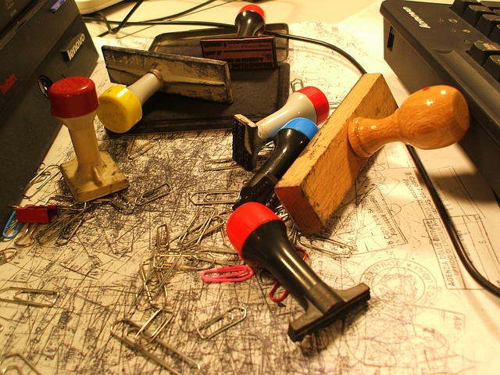
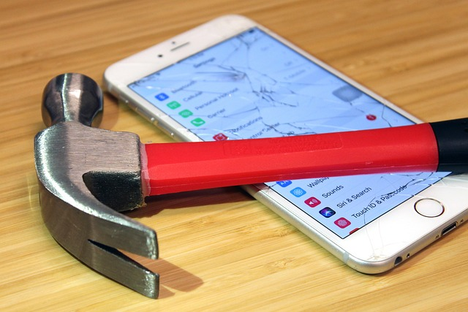
Processes – why they are key
Importance of Efficient Processes
Everyday experiences highlight frustration with slow, outdated, or redundant processes.
In healthcare, efficient processes are critical to improving patient care and satisfaction.
Goals of Process Organisation
Streamlines tasks to reduce unnecessary delays and improve the patient journey.
Helps patients access timely, well-coordinated care with clear communication.
Adopting a Customer-Centered Approach
Shifting from “this is how it’s always been” to questioning and improving processes.
Any staff member can drive meaningful improvements through customer-focused thinking.
Project: 101101139 — H-PASS — EU4H-2022-PJ

Slide 6
What are processes?
Supporting processes
Preparation
Admission
Diagnostics
Therapy
Discharge
Post-care
Patient
Patient
Care & Treatment During Hospital Stay
Assessment
Nursing diagnosis
Planning
Delivery
Evaluation
Project: 101101139 — H-PASS — EU4H-2022-PJ

Slide 7
Exercise: Put the process in order
EMT: emergency call, triage, alert, dispatch/response, care, transport, handover
Hospital care: preparation, admission, diagnostics, therapy, discharge, post-care
Nursing: assessment, nursing diagnostics, planning, delivery, evaluation
Pharmacy: Receiving prescripton, Validation of prescription, Chosing and Preparation of medication, Medication Verification and Patient Counseling, Medication Dispensing and registering, Post-care
Project: 101101139 — H-PASS — EU4H-2022-PJ

Slide 8
!
Hierarchy
Subsystems, institutes, departments etc.
units, teams, indiviuals
Patients do not need to understand your processes!
Project: 101101139 — H-PASS — EU4H-2022-PJ

Slide 9
Make your processes person-centred
External customer (patient)
observe / shadow
ask / interview
get feedback
map their experience
analyse data
Internal customer
(colleague)
time and ways for discussing collaboration
setting common goals
channels for communication and information exchange
Project: 101101139 — H-PASS — EU4H-2022-PJ

Slide 10
Exercise: Match internal & external clients (match) of a healthcare system process
Internal:
Nurse
Doctor
Cleaning lady
Receptionist
Pharmacist
GP
Procurer
External:
Patient
Patient’s family
Project: 101101139 — H-PASS — EU4H-2022-PJ

Slide 11
EFFECTIVENESS
EFFICIENCY
We are doing
“the right things”
We are doing
“things right”
Quality
Time
Cost
Project: 101101139 — H-PASS — EU4H-2022-PJ

Slide 12
Where to start?
Critical processes are core (sometimes supportive) processes that have the most direct impact on customer satisfaction and service levels.
Regular or frequently repeated
Involve the participation of many internal employees or departments
Affect all or most customers
Their effective & efficient execution significantly determines the organisation's performance
Project: 101101139 — H-PASS — EU4H-2022-PJ

Slide 13
What can be signs of a bad process?
Information gaps
slow processing
excessive paperwork
long waiting lists
several stakeholders
unfriendly behavior
Project: 101101139 — H-PASS — EU4H-2022-PJ

Slide 14
What can be the reasons behind?
Unnecessary duplications
Excessively fragmented activities
Unnecessary checkpoints in the process
Custom solutions for activities that can be standardised
Lack of IT support, reliance on paper-based solutions
Project: 101101139 — H-PASS — EU4H-2022-PJ

Slide 15
Digitalisation & processes
Possibilities for digitalisation
Possibilities for process improvement
The use of technology must always serve the process objective, but we have to ask:
is it the right objective?
Project: 101101139 — H-PASS — EU4H-2022-PJ

Slide 16
External content: digital solutions in process optimalisation – click for examples
EHR/EMR
Telemedicine (virtual wards, GP visit)
Wearable devices and IoTs
AI and machine learning
RPA
Data management and analytic tools
Mobile health applications
VR & AR
Blockchain
3D printing
Multimodal Large Language Models
Project: 101101139 — H-PASS — EU4H-2022-PJ
Notes:
Mobile health apps
Samsung health vs Google fit : https://www.youtube.com/watch?v=Dk-pBTtzpjA
Apple health: https://www.youtube.com/watch?v=kmYMiJmo-O0
Mental health apps:
https://www.youtube.com/watch?v=jtbEvj4xs8U
https://www.youtube.com/watch?v=4UDkKjkyO8Q

Slide 17
How to create good processes?
Quality
Time
Sit down and talk ☺:
Direct and interprofessional colleagues
Other departments
Other organisations, cross-sector too
Key individuals/groups
Patients and clients!
Cost
Service Design
Lean and
6 sigma
Project: 101101139 — H-PASS — EU4H-2022-PJ

Slide 18
External content: lean 6 sigma
Project: 101101139 — H-PASS — EU4H-2022-PJ

Slide 19
External content: service design
Online Tools and Guides for Applying Service Design Methodology:
Explore these resources for tools and methods to effectively implement service design:
This is Service Design Doing – Methods
Service Design Tools
Service Design Toolkit - Downloads
Project: 101101139 — H-PASS — EU4H-2022-PJ

Slide 20
External Content: Methods for Depicting Processes
More on Flowcharts and Process Mapping Tools:
For additional insights into creating flowcharts, visit: SmartDraw Flowchart Guide
You have various tools available to help map out your processes:
Sketch it out on paper for a quick start
PowerPoint for basic flowcharting
Canva, Miro, and others for more design-focused diagrams
SmartDraw, Lucidchart, and similar apps for advanced flowchart creation
Explore other specialised applications for tailored needs
Project: 101101139 — H-PASS — EU4H-2022-PJ

Slide 21
True/False Exercise for the Three Videos
Lean Six Sigma
The PDCA cycle, which stands for Plan, Do, Check, Act, is a tool used in Lean Six Sigma. (T/F)
Lean Six Sigma focuses exclusively on short-term gains and overlooks long-term improvements. (T/F)
Service Design
Service design in an emergency waiting room aims to enhance both patient flow and patient experience. (T/F)
Service design focuses solely on improving the patient experience, disregarding staff needs. (T/F)
Process Flow Charts
Process flow charts visually represent the steps in a process. (T/F)
Flow charts are not useful for improving communication among team members. (T/F)
Project: 101101139 — H-PASS — EU4H-2022-PJ
Notes:
Answers: True
The PDCA cycle, which stands for Plan, Do, Check, Act, is a tool used in Lean Six Sigma.
Service design in an emergency waiting room aims to enhance both patient flow and patient experience.
Process flow charts visually represent the steps in a process

Slide 22
You can change processes too! Two examples to inspire action
Project: 101101139 — H-PASS — EU4H-2022-PJ

Slide 23
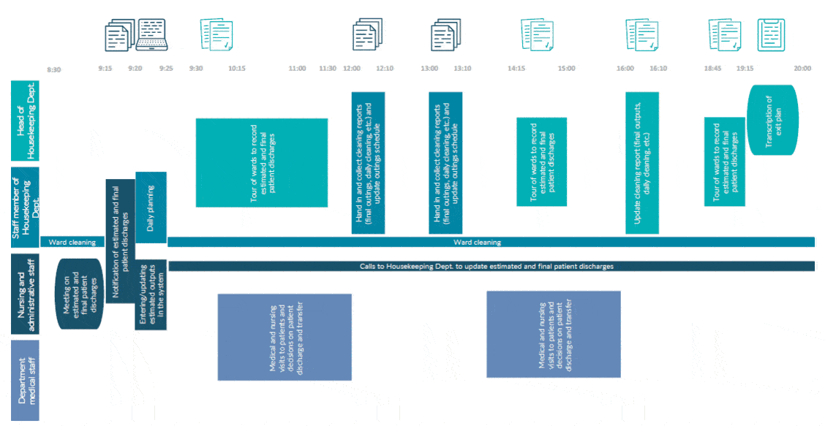
EOC Lugano Regional Hospital, Switzerland – 2023
Problem: How to provide better patient and staff safety regarding hospital higiene with a shortage of cleaning staff while reducing costs?
Solution: Implementation of a hospitality management system → tablets on the cleaning carts.
Results:
Improved internal communication
Increased monitoring
Better allocation of service costs and human resources
Significantly decreased infection risk and connected costs
Higher patient satisfaction
Source: F. U. Mion (2024): From hotel to hospital: technological transfer and process innovation in the housekeeping department, presented at EHMA 2024
Project: 101101139 — H-PASS — EU4H-2022-PJ

Slide 24
It is always the frontline employees who understand processes the best. Don’t wait for the context to be favourable for change; start the change yourself. With processes, you can always start small.
Project: 101101139 — H-PASS — EU4H-2022-PJ

Slide 25
Conclusion
This course demonstrated how effective process design was essential in addressing inefficiencies and enhancing patient experiences.
Through process improvement techniques and digital tools, healthcare teams learned to optimize workflows, reduce unnecessary costs, and provide a more seamless patient journey.
The lesson emphasised that process improvement required ongoing commitment, adapting to new needs and technologies to drive sustainable advancements in healthcare quality and delivery.
Project: 101101139 — H-PASS — EU4H-2022-PJ

Slide 26
References
Dobák, M., & Antal, Z. (2015). Vezetés és szervezés: Szervezetek kialakítása és működtetése. Akadémiai Kiadó.
Mion. F. U. (2024): From hotel to hospital: technological transfer and process innovation in the housekeeping department, presented at EHMA 2024.
Project: 101101139 — H-PASS — EU4H-2022-PJ

Slide 27
Copyright notice
Copyright © Members of the H-PASS Project. For details about the H-PASS Project and collaboration, please visit: https://hpass.healthworkforce.eu/index.php/the-project/
H-PASS the “Health Professionals’ and the “DigitAl team” SkillS advancement” is a project co-funded by the European Health and Digital Executive Agency (HaDEA) under the powers delegated by the European Commission. H-PASS began in May 2023 and will run for 3 years.
This work is licensed under the Creative Commons Attribution-Noncommercial 3.0 License. To view a copy of this license, visit http://creativecommons.org/licenses/by-nc/3.0/ or send a letter to Creative Commons, 171 Second Street, Suite 300, San Francisco, California, 94105, and USA.
The work must be attributed by attaching the following reference to the copied elements: “Copyright © Members of the H-PASS Project ”.
Using this presentation in a way and/or for purposes not foreseen in the license, requires the prior written permission of the copyright holders. The information contained in this presentation represents the views of the copyright holders as of the date such views are published.
Project: 101101139 — H-PASS — EU4H-2022-PJ

Slide 28
Disclaimer
The European Health and Digital Executive Agency (HaDEA), under the powers delegated by the European Commission, supports the production of this publication. The European Commission's support does not constitute endorsement of the contents, which reflects the views only of the authors. The Commission cannot be held responsible for any use that may be made of the information contained therein.
Project: 101101139 — H-PASS — EU4H-2022-PJ

Slide 29
Thank You
Project: 101101139 — H-PASS — EU4H-2022-PJ

