Slide 1
Managing healthcare development
Project: 101101139 — H-PASS — EU4H-2022-PJ

Slide 2
Contents
Introduction
Project Management Essentials
Project Phases and Planning
Executing and Managing the Project
Risk Management
Project Closure
Conclusion
Project: 101101139 — H-PASS — EU4H-2022-PJ

Slide 3
Learning objectives
Identify key characteristics of healthcare projects and their impact.
Understand the role of project management in achieving healthcare goals.
Use project management tools like WBS, Gantt charts, and risk frameworks.
Manage teams effectively to ensure collaboration and meet milestones.
Conduct project closure and apply lessons learned for improvement.
Project: 101101139 — H-PASS — EU4H-2022-PJ

Slide 4
Introduction
Significance of Project Management in Healthcare
Essential for improving efficiency and ensuring high-quality healthcare services.
Addresses the healthcare sector's unique challenges, from resource limitations to complex stakeholder needs.
Course Focus
Provides a foundational understanding of project management tailored to the healthcare context.
Emphasises strategies for managing time, aligning stakeholders, and optimizing resources.
Empowering Healthcare Professionals
Equips participants with practical tools for planning, executing, and evaluating healthcare projects.
Prepares professionals to lead projects confidently, enhancing patient outcomes and driving positive community impact.
Project: 101101139 — H-PASS — EU4H-2022-PJ

Slide 5
From simple to complex
Some inefficiency in our work environment can be improved through project management.
We don’t necessarily have to think about big changes. Even a small inefficiency could be addressed with this approach.
Let’s think, for example, about the long waiting lists for patients in need of healthcare services.
Image by storyset su Freepik
Project: 101101139 — H-PASS — EU4H-2022-PJ

Slide 6
Definition of Project
A healthcare project can be defined as “a temporary endeavour undertaken to create a unique service, product or outcome with a predeterminate budget”
Image by mindandi on Freepik
Project: 101101139 — H-PASS — EU4H-2022-PJ

Slide 7
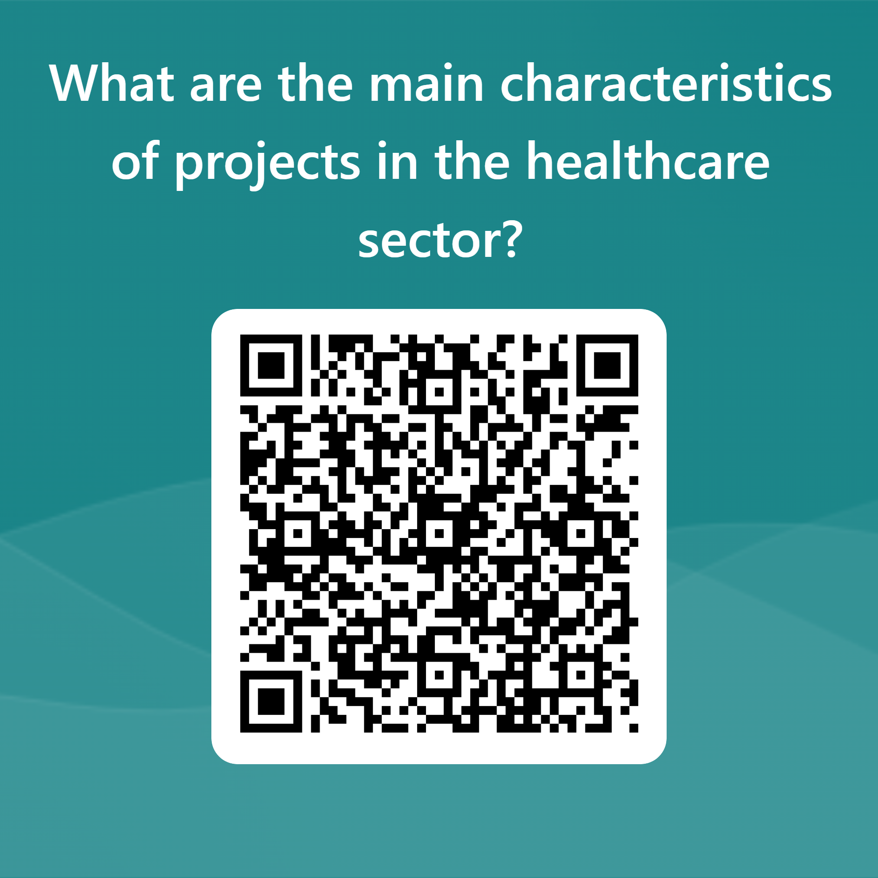
The main characteristics of healthcare project
Temporariness: project has a finite duration. It has a start date and a completion date;
Uniqueness: each healthcare project is unique due to its specific context, objectives and required solutions;
Complexity: healthcare project typically involve multiple stakeholders, process and technologies;
Interdisciplinarity: project team in healthcare consist of professionals from various fields (healthcare providers, IT specialists, administrators and legal experts);
Limited resources: financial, temporal and human resources;
Impact on patients and the community
Image by katemangostar on Freepik
Project: 101101139 — H-PASS — EU4H-2022-PJ

Slide 8
Importance of Project Management
Project Management (PM) is “the process of planning, organising, directing and controlling a group of work, as a temporary team”
The goal of PM are:
Completing the project on time;
Completing the project with budget;
Achieving the scope of work.
TIME
BUDGET
SCOPE
Project: 101101139 — H-PASS — EU4H-2022-PJ

Slide 9
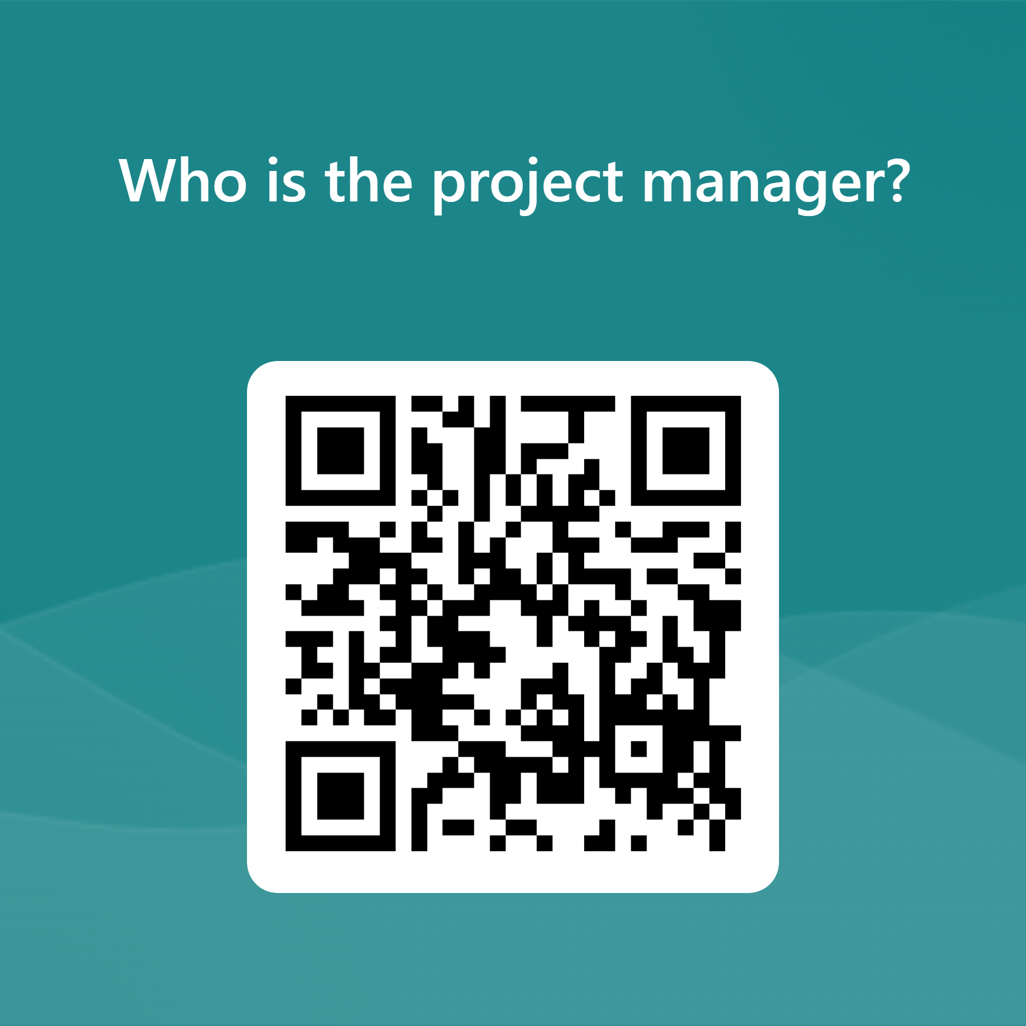
Project Manager (PgM)
is a person assigned by the organisation to lead the project team
His main responsabilities are::
Defining project goal and the project plan;
Optimising resource utilisation;
Monitoring progress & taking corrective actions;
Coordinating a multidisciplinary team;
Managing relationships with stakholders.
PgM has a role of responsability
Image by Sentavio on Freepik
Project: 101101139 — H-PASS — EU4H-2022-PJ

Slide 10
Stakeholder Mapping
NR. | Stakeholder | Role | Influence (H=high; L=low) | Interest (H=high; L=low) | Objective/interest with the project | Risk | Attitude towards the project
Example S1 | Peter Müller | Financial decision-maker | H | L | … | … | Neutral
Example S2 | Kevin Peer | IT responsible | H | L | … | … | Negative
Example S3 | Veronica Smith | Head nurse | L | H | … | … | Positive
… | … | … | … | … | … | … | …
Project: 101101139 — H-PASS — EU4H-2022-PJ

Slide 11
Project life cycle
Initiation & planning
Executing
Monitoring & controlling
Closing
Project: 101101139 — H-PASS — EU4H-2022-PJ

Slide 12
Project planning
The project charter must be approved;
The objectives must be defined;
The stakeholders must be identified;
A project team must be created;
A Gantt chart needs to be built;
A budget must be quantified;
The plans (Risk Management, Quality, Procurement, Communications) need to be drafted;
The WBS, the OBS, & the RAM need to be developed.
Image by katemangostar on Freepik
Project: 101101139 — H-PASS — EU4H-2022-PJ

Slide 13
Setting project goals & objectives
The starting point for project planning is need analysis
The objective must be Specific, Measurable, Achievable, Relevant And Time-bound
SMART
Project: 101101139 — H-PASS — EU4H-2022-PJ

Slide 14
Image by Alexandr Podvalny on Unsplash
Work Breakdown structure (WBS)
It is a valuable tool for breaking down the project into manageable work packages.
Project: 101101139 — H-PASS — EU4H-2022-PJ

Slide 15
Work Breakdown structure (WBS)
Image by Leone Venter on Unsplash
Project
Milestones
Milestones
Work packages
Work packages
Work packages
Work packages
Work packages
Work packages
Deliverable
Project: 101101139 — H-PASS — EU4H-2022-PJ

Slide 16
Gantt Charts
Image by Vanalya on Freepik
The Gantt chart is a project management tool useful for planning, organising and monitoring project activities;
The Gantt chart allows for a visual representation of the overall project progress.
Project: 101101139 — H-PASS — EU4H-2022-PJ

Slide 17
Example of Gantt Chart
Project: 101101139 — H-PASS — EU4H-2022-PJ

Slide 18
Action Plan
Image by Markus Spiske on Unsplash
An Action Plan in project management is a detailed strategy outlining the tasks and steps necessary to achieve project goals.
Task | Scheduling | Responsible(s) | Contributor(s) | Tools/method | Result/output/product | Status
Example – Phase 0 | 01/01/2025 - 30/06/2025
Example - Task 0.1 | 01/01/2025 – 31/03/2025 | Olivia Brooks (Project Manager) | Emma Harrison (support staff) Liam Porter (support staff) | … | … | In Progress
Example - Task 0.2 | 01/01/2025 – 31/03/2025 | Ethan Miller (Resource Lead) | Isabella Reed (support staff) Jackson Hayes (support staff) | … | … | Not Started
…
Phase 1
…
…
…
Phase 2
…
…
…
Project: 101101139 — H-PASS — EU4H-2022-PJ

Slide 19
Team Managemnet
The PgM must:
Select the team;
Assign roles and responsibilites;
Promote open, clear and frequent communication;
Organise collaborative work sessions;
Manage and resolve conflicts;
Mediate between interests.
Team management is the set of techniques and methodologies for creating and managing a work group
Project: 101101139 — H-PASS — EU4H-2022-PJ

Slide 20
Image by Jud Mackrill on Unsplash
Effective Team management requires careful member selection, clear assignment of role and responsabilities, open and collaborative communication, conflict management, and a project manager capable of guiding and supporting the team.
Project: 101101139 — H-PASS — EU4H-2022-PJ

Slide 21
Communication
Communication is a fundamental element for effectively managing a project team.
Image by freepik
Project: 101101139 — H-PASS — EU4H-2022-PJ

Slide 22
In the communication…
the project manager must:
Plan external communication
Plan internal team communication
Image by freepik
Project: 101101139 — H-PASS — EU4H-2022-PJ

Slide 23
Monitoring project progress
Continuous monitoring of project’s progress and the adoption of corrective actions are essential to ensure the achievement of objectives.
Useful tools for this phase are:
Regular reporting;
Variance analysis;
Project plan review.
Image by storyset on Freepik
Project: 101101139 — H-PASS — EU4H-2022-PJ

Slide 24
Risk management (1)
In a project, “a risk” is considered any event that has a certain probability of occurring.
Image by d3images on Freepik
Project: 101101139 — H-PASS — EU4H-2022-PJ

Slide 25
Risk management (2)
It is crucial to conduct an analysis to identify and assess potential project risk, evaluating their impact and likelihood of occurrence.
Risks can be:
technical
organisational
Image by storyset on Freepik
Project: 101101139 — H-PASS — EU4H-2022-PJ

Slide 26
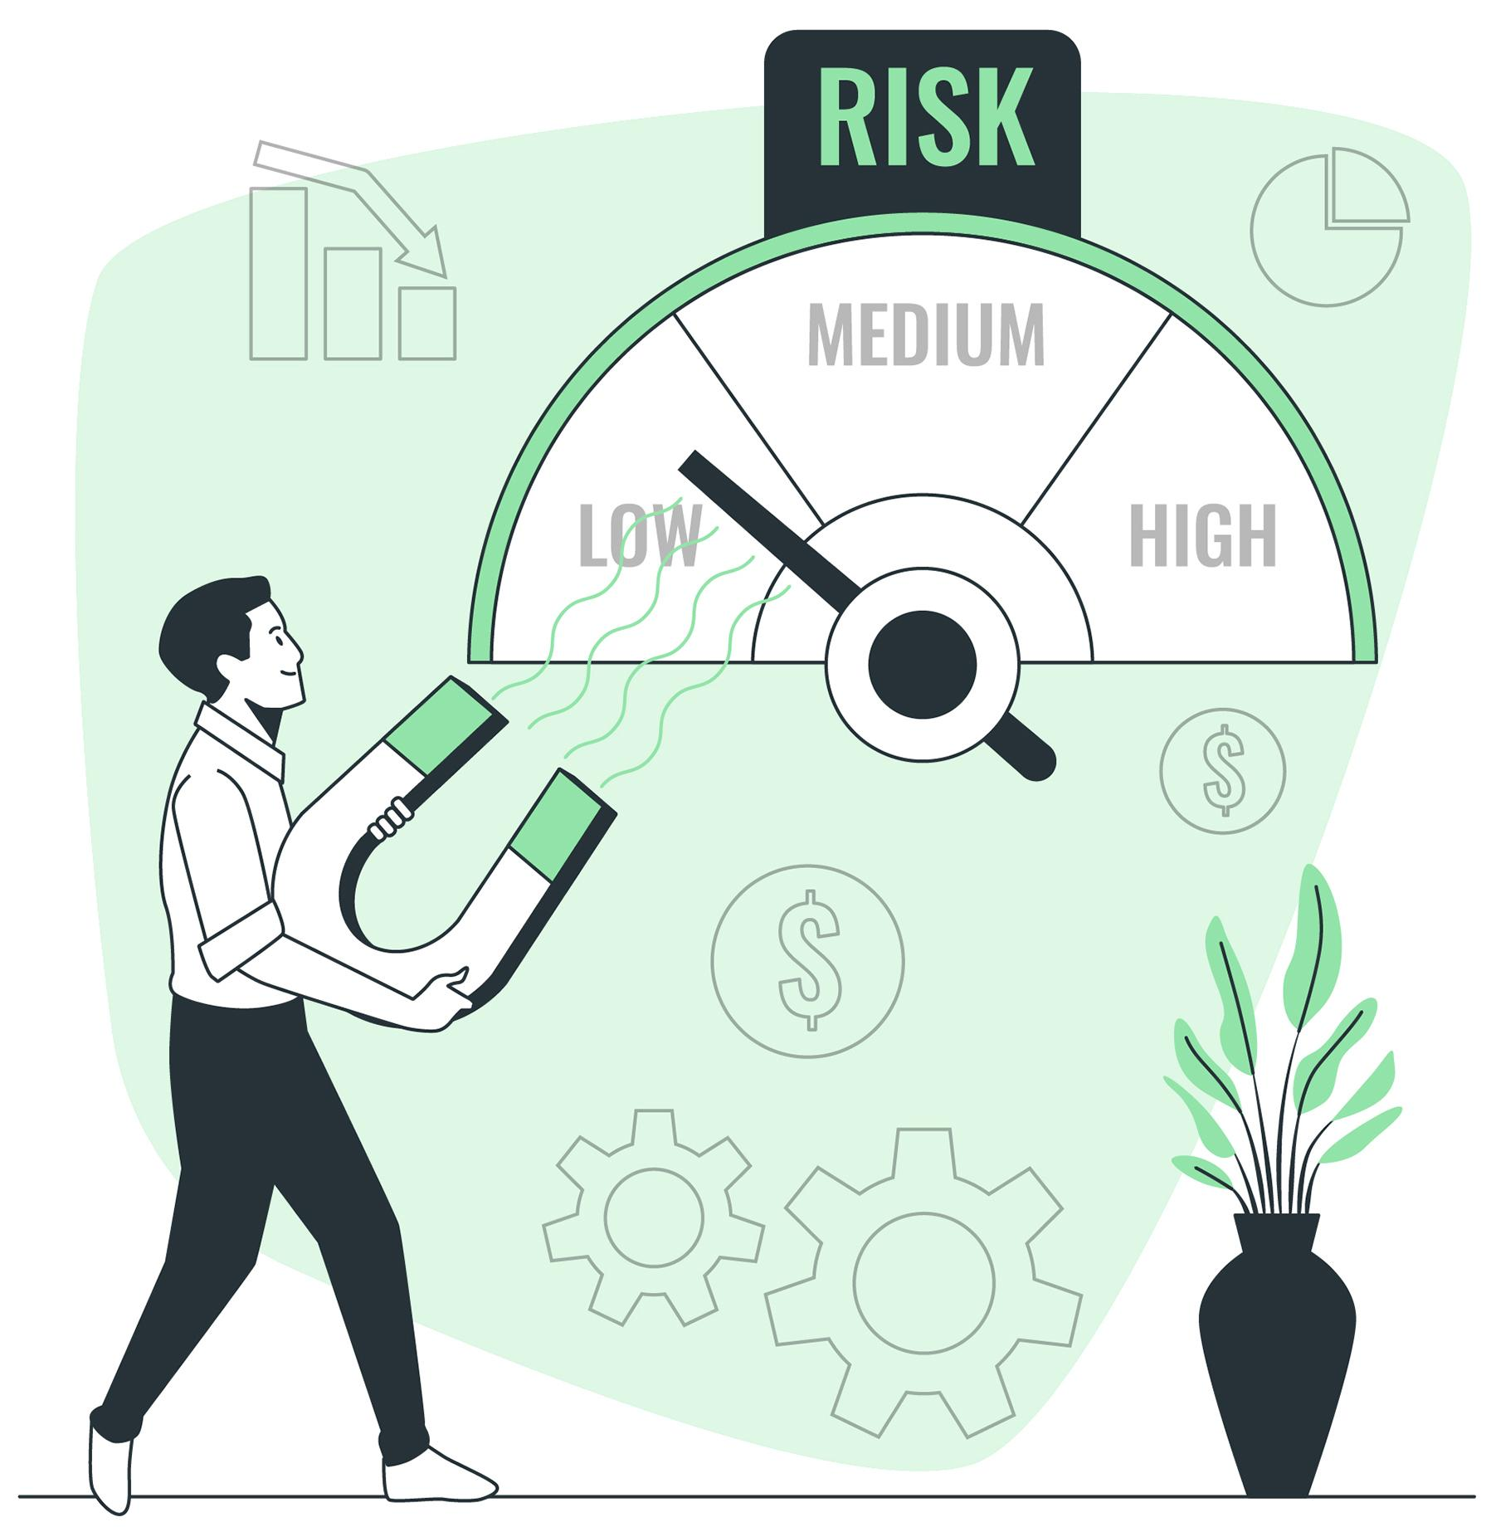
The classification of risk
Low risk
Medium risk
High risk
Lessons learned and the best practices should be shared within the organisation to improve future risk management.
Image by storyset on Freepik
Project: 101101139 — H-PASS — EU4H-2022-PJ

Slide 27
The action is based on the risk
If the risk is low, risks are considered accepted
If the risk is medium, corrective measures must be taken
If the risk is high, preventive measures must be taken
Project: 101101139 — H-PASS — EU4H-2022-PJ

Slide 28
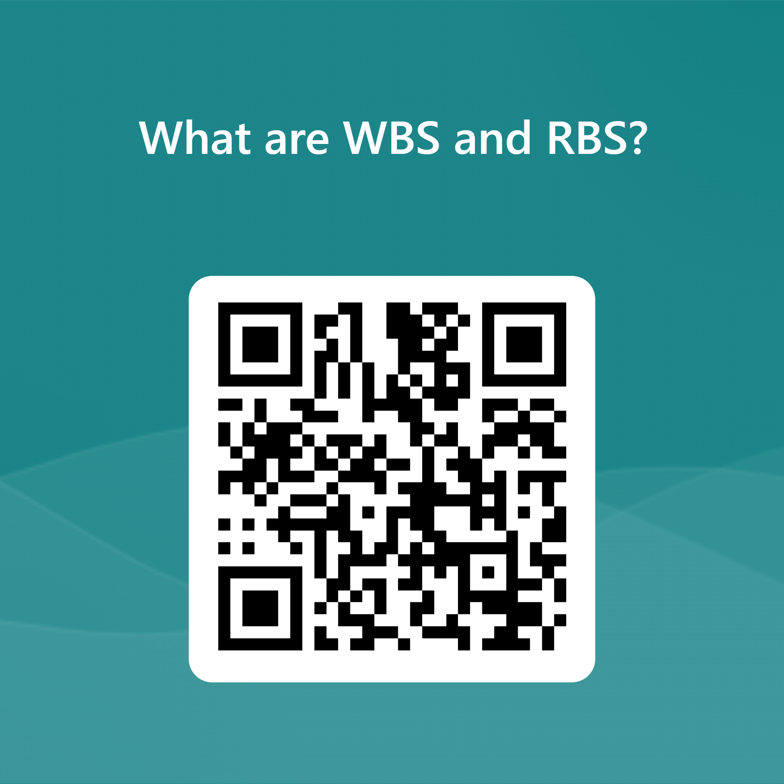
Risk Breakdown Structure (RBS)
A Useful tool for defining risk categories is the RBS
Project
Technical
External
Organisational
Internal
Project: 101101139 — H-PASS — EU4H-2022-PJ

Slide 29
Closing out project activities
The project finish with Close out Meeting.
In the project closure phase:
Results are achieved
Lessons learned are evaluated
Project documents are archived
Image by macrovector on Freepik
Project: 101101139 — H-PASS — EU4H-2022-PJ

Slide 30
Lessons learned & project evaluation
The final evaluation of the project is essential for identifying areas of improvement and sharing best practices.
Sharing lessons learned represent an opportunity to improve the management of future projects and disseminate knowledge within the organisation.
Image by Freepik
Project: 101101139 — H-PASS — EU4H-2022-PJ

Slide 31
Conclusion
Image by freepik
Achieving Success Efficiently
Project management helps healthcare organisations meet goals through strong leadership, collaboration, and effective tools.
Transforming Ideas into Results
Focus on planning, communication, team management, and risk assessment ensures impactful outcomes.
Improving Efficiency and Quality
Leadership and structured tools help overcome challenges, stay on budget, and enhance service quality.
Driving Meaningful Change
Project management empowers healthcare professionals to improve patient outcomes and drive positive change in healthcare.
Project: 101101139 — H-PASS — EU4H-2022-PJ

Slide 32
References
Antonio Volpe – Project Management Institute - “Introduzione al project Management secondo i principi del PMBOK”;
Beukers MW. “Project management of life-science research projects: project characteristics, challenges and training needs”;
G. Sancetta, C. Simone “Project Management – Corso di Management A.A. 2021-2022”;
Guanci, Gen MEd, RN-BC, CCRN-K; Bjork, Chris PMP. “An introduction to project management. Nursing Management (Springhouse)”;
Headvisor. (n.d.). Work Breakdown Structure: Innovation Manager. Retrieved from headvisor.com
Maurizio Dal Maso “project management in sanità: una scelta obbligata”. RivistaPM_Articolo PM_DalMaso_2009.pdf (uniroma1.it);
Mohamadi, Samad Agha et al. “The role of project management offices (PMOs) in healthcare system.” (2002);
Perano Mirko – Università degli Studi di Salerno - “il Project Management” nel libro “La visione Strategica dell’impresa”, p.p. 259-287, Chapter 13, Giappichelli Editore, Torino;
Project Management Institute “The standard for project management and a guide to the project management body of knowledge (PMBOK guide)”;
Sa Couto J. Project management can help to reduce costs and improve quality in health care services. J Eval Clin Pract. 2008;
Slideshare. (n.d.). Le basi del project management [Slideshow]. Retrieved from https://www.slideshare.net/slideshow/le-basi-del-project-management
University of Padua. (n.d.). Project Management Dispense v1.3 [PDF]. Retrieved from University of Padua: https://www.unipd.it
Zimmer BT. “Project management: a methodology for success.”, Hosp Mater Manage Q.

Slide 33
Copyright notice
Copyright © Members of the H-PASS Project. For details about the H-PASS Project and collaboration, please visit: https://hpass.healthworkforce.eu/index.php/the-project/
H-PASS the “Health Professionals’ and the “DigitAl team” SkillS advancement” is a project co-funded by the European Health and Digital Executive Agency (HaDEA) under the powers delegated by the European Commission. H-PASS began in May 2023 and will run for 3 years.
This work is licensed under the Creative Commons Attribution-Noncommercial 3.0 License. To view a copy of this license, visit http://creativecommons.org/licenses/by-nc/3.0/ or send a letter to Creative Commons, 171 Second Street, Suite 300, San Francisco, California, 94105, and USA.
The work must be attributed by attaching the following reference to the copied elements: “Copyright © Members of the H-PASS Project ”.
Using this presentation in a way and/or for purposes not foreseen in the license, requires the prior written permission of the copyright holders. The information contained in this presentation represents the views of the copyright holders as of the date such views are published.
Project: 101101139 — H-PASS — EU4H-2022-PJ

Slide 34
Disclaimer
The European Health and Digital Executive Agency (HaDEA), under the powers delegated by the European Commission, supports the production of this publication. The European Commission's support does not constitute endorsement of the contents, which reflects the views only of the authors. The Commission cannot be held responsible for any use that may be made of the information contained therein.
Project: 101101139 — H-PASS — EU4H-2022-PJ

Slide 35
End of learning unit
Project: 101101139 — H-PASS — EU4H-2022-PJ

